Slide 1

SMART LIGHT
MUHAMMAD FARID IZWAN BIN MOHAMAD SHABRI

Slide 2
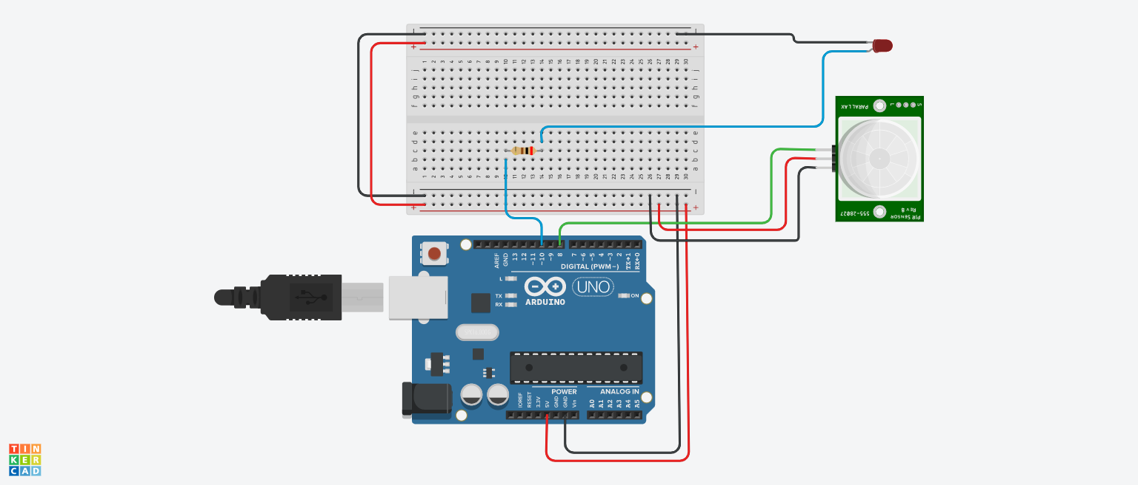
LINK: https://www.tinkercad.com/things/9yXxFvOH3eZ-copy-of-light-activation-using-motion-sensor/editel?sharecode=jNy04gS0jfyRJ9fzd4gmDztHPYvU4zww8H2lanb5rNs

